Slide 1


Aspect Category Sentiment Analysis on a Challenging Dataset
By Kiran Negi and Saumitra Das
School of Computing, DCU

Slide 2
Content
Introduction
Aspect Based Sentiment Analysis
Aspect Category Sentiment Analysis
The Challenging Dataset
Aspect Category Detection
Aspect Category Sentiment Classification

Slide 3


Introduction
Sentiment analysis helps in identifying the sentiment of a sentence and often classifies them as positive, negative and neutral.
Understanding customers’ feelings towards a specific product, brand or commercial establishment are essential for companies and organizations.

Slide 4
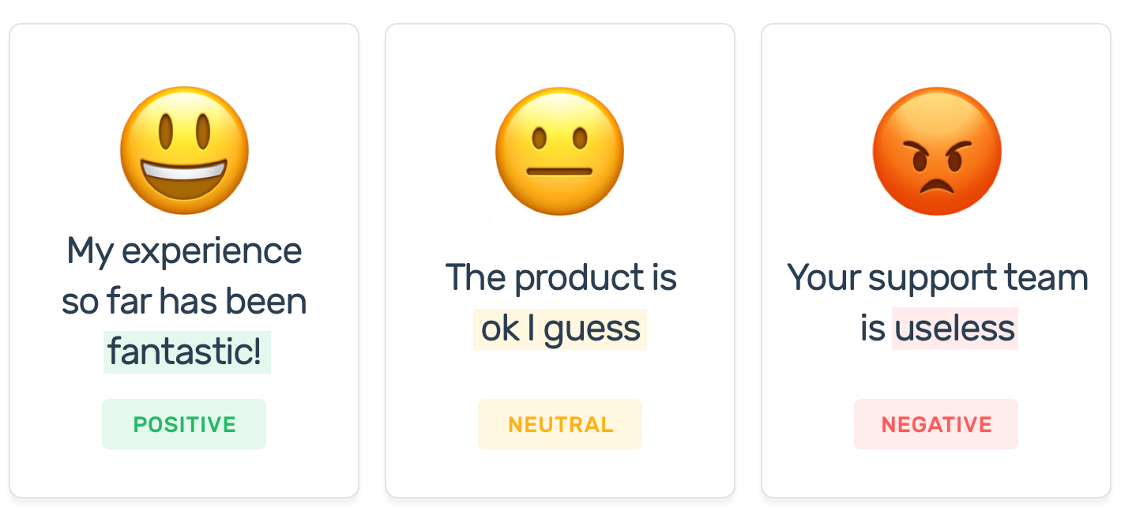
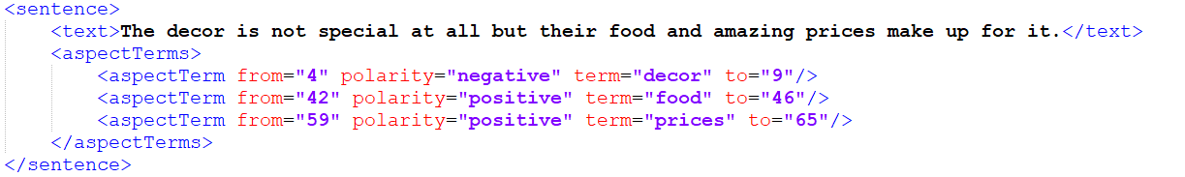
Introduction
Traditional sentiment analysis
A fine-grained Aspect Based Sentiment Analyser can predict sentiments associated with specific aspects in a text.

Slide 5
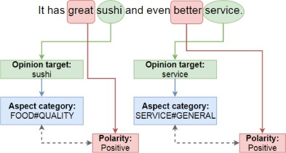
Aspect Based Sentiment Analysis
Aspect Term Sentiment Analysis
Aspect term appears explicitly in the text
Aspect Category Sentiment Analysis
Pre-defined aspect categories related to aspect terms, expressed implicitly

Slide 6
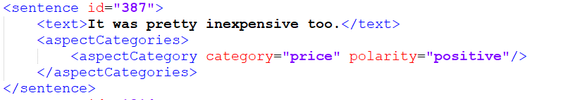
Aspect Category Sentiment Analysis
Aspect Category Detection
Aspect Category Sentiment Classification

Slide 7
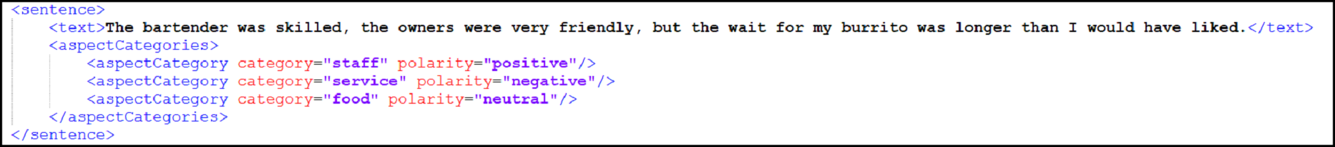
The Challenging Dataset
Only 454 instances (out of 4748) of SemEval-2014 Restaurant dataset contain multiple aspect categories with different sentiment polarities.
MAMS (Multi-Aspect Multi-Sentiment) dataset
Each instance of MAMS dataset contains at least two different aspect categories with different sentiment polarities.
8879 instances present in MAMS dataset which is 1.87 times of SemEval-2014 Restaurant Review dataset.

Slide 8
Aspect Category Detection
The critical challenge in this subtask stems from the fact that in most cases, the aspect category may not appear in the sentence explicitly.
Based on related works, we approached this task with the following methods:
Classical statistics-based Bags-of-Words feature using SVM
Static Word Embedding using deep-learning neural network CNN
Contextualized Word Embedding using language model BERT

Slide 9
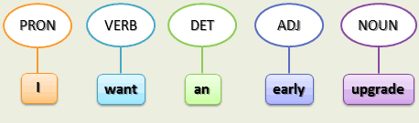
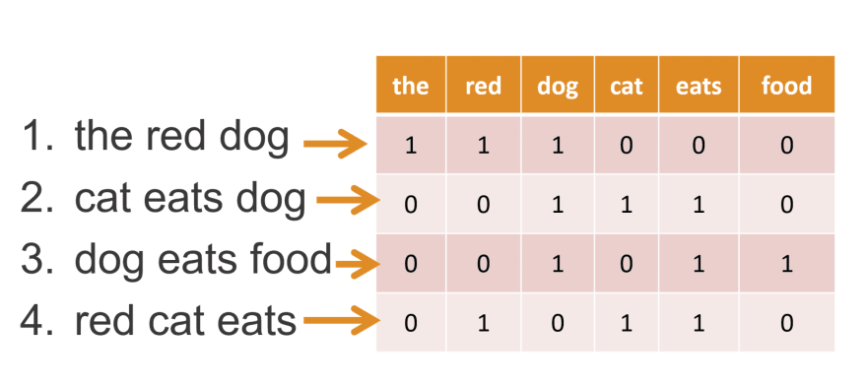
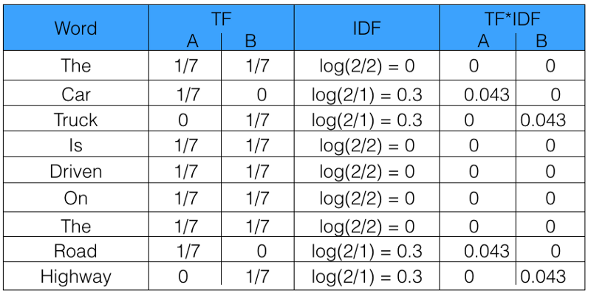
Aspect Category Detection 1. Classical BoW methods
Initially, we implemented the classical SVM model as a multi-label classifier on the MAMS dataset by using the following feature engineering technique:
POS-tagging reviews and filter the words with tag- noun, adjective, verb, adverb
Building BOW model using CountVectorizer
Building BOW model using TfidfVectorizer

Slide 10
Aspect Category Detection 1. Classical BoW methods
But none of the methods produced F1-score of more than 60.
It proves that traditional word vector representation of features will not work efficiently on the MAMS dataset.

Slide 11
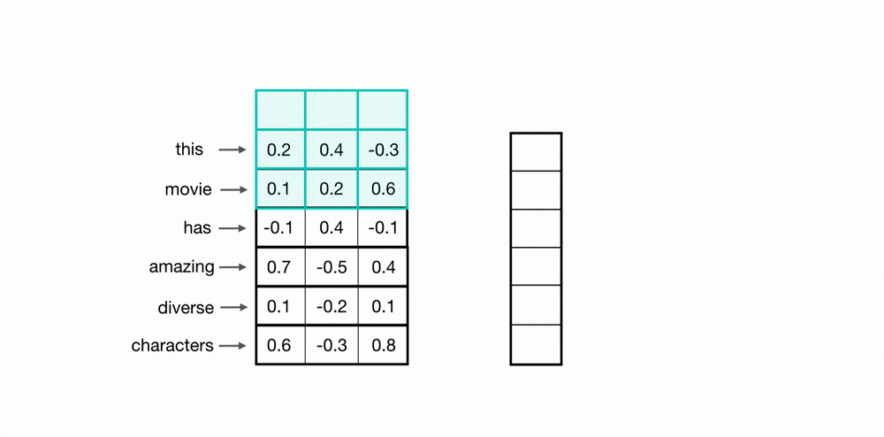
Aspect Category Detection 2. Deep-learning word-embedding methods
Model
Feed-Forward deep learning CNN model
Simple 1Dimensional-CNN classifier for each aspect category
Kernel size of 3 (3-gram) and 64 feature-maps

Slide 12
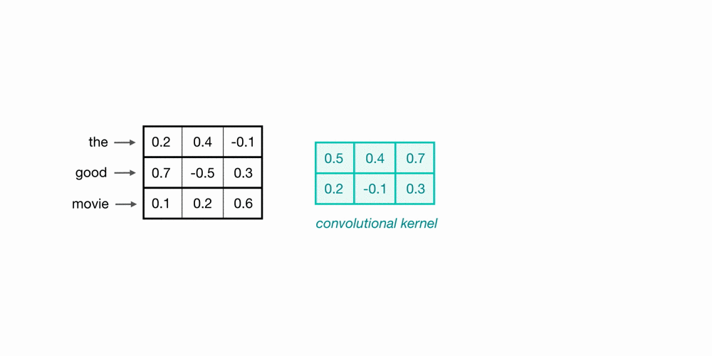
Aspect Category Detection 2. Deep-learning word-embedding methods
Pre-trained Word Embeddings
Glove and Word2Vec
Glove consists of 300-dimensional word vectors trained on 840 billion tokens of the Common Crawl corpus using a large vocabulary of 2.2 million words
Google News Dataset is used for creating Word2Vec embeddings, which contains 300-dimensional vectors for 3 million words and phrases

Slide 13
Aspect Category Detection 2. Deep-learning word-embedding methods
Pre-trained Word Embeddings
For example, in the sentence
“The restaurant is located pretty far from my flat, but I love the flat noodles they serve.”,

Slide 14
Aspect Category Detection 3. Pre-trained Language model
BERT makes use of Transformer, an self-attention mechanism that learns contextual relations between words (or sub-words) in a text.
Transformer includes two separate mechanisms — an encoder that reads the text input and a decoder that produces a prediction for the task. But BERT only has an encoder with a classifier added on top.
MobileBERT is a thin version of BERT_{LARGE} which we used for the contextual representation of the reviews.

Slide 15
Aspect Category Detection 3. Pre-trained Language model
MobileBERT is 4.3 times smaller and 5.5 times faster than BERT_{BASE}
On the natural language inference tasks of GLUE, MobileBERT can achieve a GLUE score of 77.7, which is only 0.6 lower than BERT_{BASE}
On the SQuAD v1.1/v2.0 question answering task, MobileBERT obtains a dev F1 score of 90.3/80.2, which is even 1.5/2.1 higher than BERT_{BASE}
Model | Hidden size | Self-attention heads | Transformer blocks
BERT_{BASE} | 768 | 12 | 12
BERT_{LARGE} | 1024 | 16 | 24
MobileBERT | 128 | 4 | 24

Slide 16
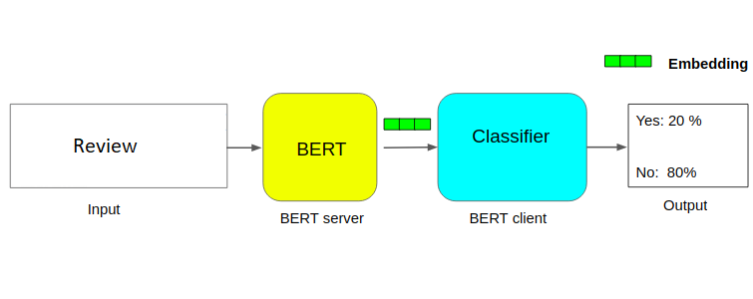
Aspect Category Detection 3. Pre-trained Language model

Slide 17
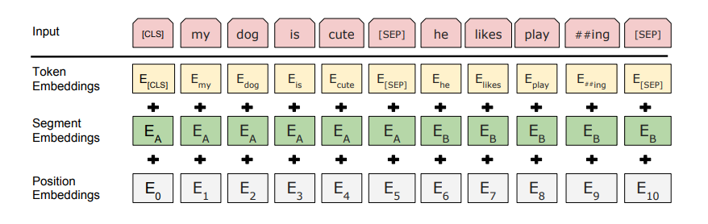
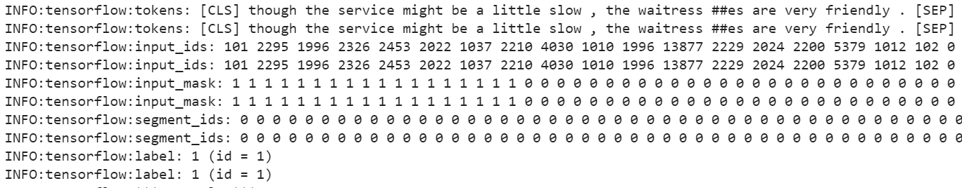
Aspect Category Detection 3. Pre-trained Language model

Slide 18
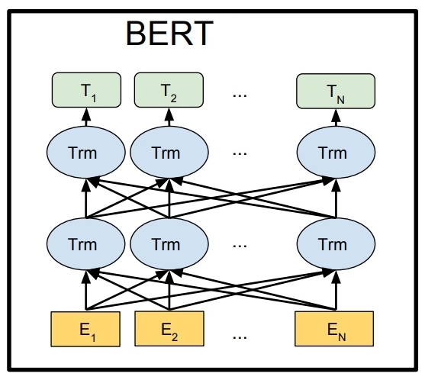
Aspect Category Detection 3. Pre-trained Language model
The BERT model is bi-directional that takes into account the order of the words in the text from left to right as well as right to left. It will generate different vectors for all different senses of a word.
As for the same example
“The restaurant is located pretty far from my flat , but I love the flat noodles they serve.”,
context
context

Slide 19
Aspect Category Detection Evaluation
The BERT model applied on SemEval-2014 Restaurant Dataset, achieves the F1-score of 90.37 beating the best submission score of 88.58 in SemEval-2014 competition.
Contextual word representations are the most efficient technique to represent text for ACD.
SemEval-2014 dataset
MAMS dataset
Model | Precision | Recall | F1score | Accuracy | AUC
Glove+CNN | 89.61 | 79.84 | 84.42 | 93.00 | 88.25
Word2Vec+CNN | 89.93 | 79.23 | 84.11 | 92.88 | 87.87
BERT | 91.15 | 89.64 | 90.37 | 95.25 | 93.21
Model | Precision | Recall | F1score | Accuracy | AUC
Glove+CNN | 87.28 | 85.07 | 85.96 | 93.63 | 89.94
Word2Vec+CNN | 87.24 | 86.28 | 86.59 | 93.94 | 90.58
BERT | 87.05 | 88.28 | 87.57 | 94.28 | 91.54

Slide 20
Aspect Category Detection Future Work
The performance of the BERT model can be further improved by fine-tuning the language model on domain-specific corpora, which is pre-trained on general text corpora.
Another interesting path for future research will be to examine cross-domain correlations for additional domains such as hotels, multiplexes, that are similar to restaurants.

Slide 21
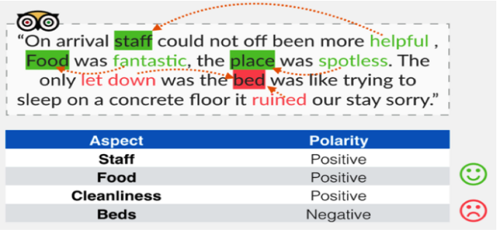
Aspect Category Sentiment Classification

Slide 22
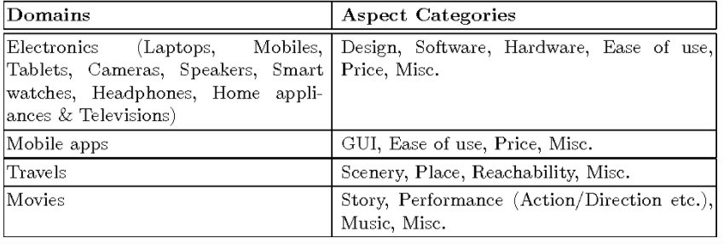
Aspect Category Sentiment Classification in various domains

Slide 23
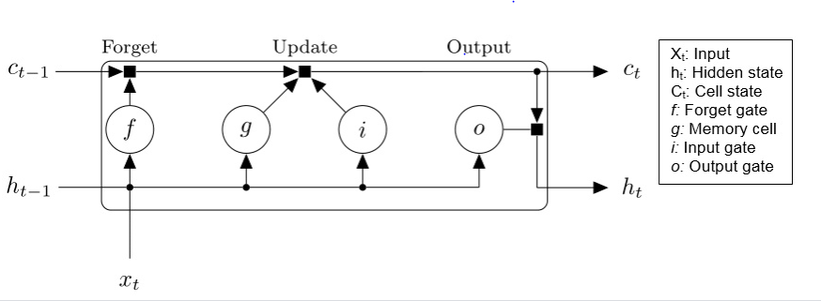
Aspect Category Sentiment Classification: Our Approach
LSTM Architecture

Slide 24
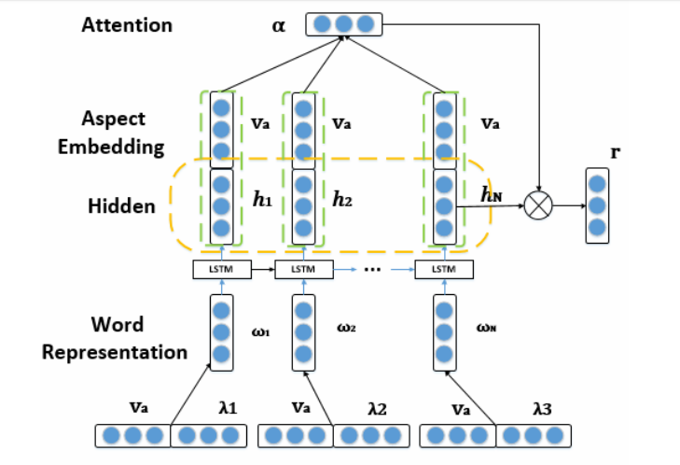
Attention based LSTM with Aspect Embedding
ATAE Architecture

Slide 25

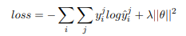
Model Training
Goal is to reduce CROSS ENTROPY LOSS
Optimized word embedding and aspect embedding during training.
Percentage of out-of-vocabulary words is about 5%, and they are randomly initialized from U(−ϵ, ϵ), where ϵ = 0.01.
Used AdaGrad as our optimization method, adapts the learning rate to the parameters.

Slide 26
Experiment
Initialized all word vectors by Glove.
Pre-trained work embedding vectors on an unlabeled corpus of size 840 billion.
Other parameters initialized by sampling from a uniform distribution U(−ϵ, ϵ).
Size of word vectors, aspect embeddings and hidden layer are 300.
The length of attention weights is the same as the length of sentence.
Theano is used for implementing our neural network models. We trained all models with a batch size of 25 examples, a momentum of 0.9, L2-regularization weight of 0.001 and initial learning rate of 0.01 for AdaGrad.

Slide 27
Evaluation
Model | Accuracy | F1
Attention based LSTM for SemEval 2014 | 76.78 | 65.78
Attention based LSTM for MAMS | 73.48 | 59.57

Slide 28

Aspect based Sentiment Classification Future work
Various existing obstacles surrounding pre-training to go in what granularity, i.e. a word, subword, character level, which structure language model would be appropriate to deal with this issue such as Transformer and LSTM, more detailed study is required in this field.
We can try to obtain more context-sensitive word representations for learning of the word embedding instead of using Word2Vec, Glove approaches.

Slide 29

Thank you!

